Slide 1

Intro to
Prompt Engineering
By Larry Battle
Image Source: https://ideogram.ai/g/TpLWpCa0RxedDe8qx_doAg/3

Slide 2
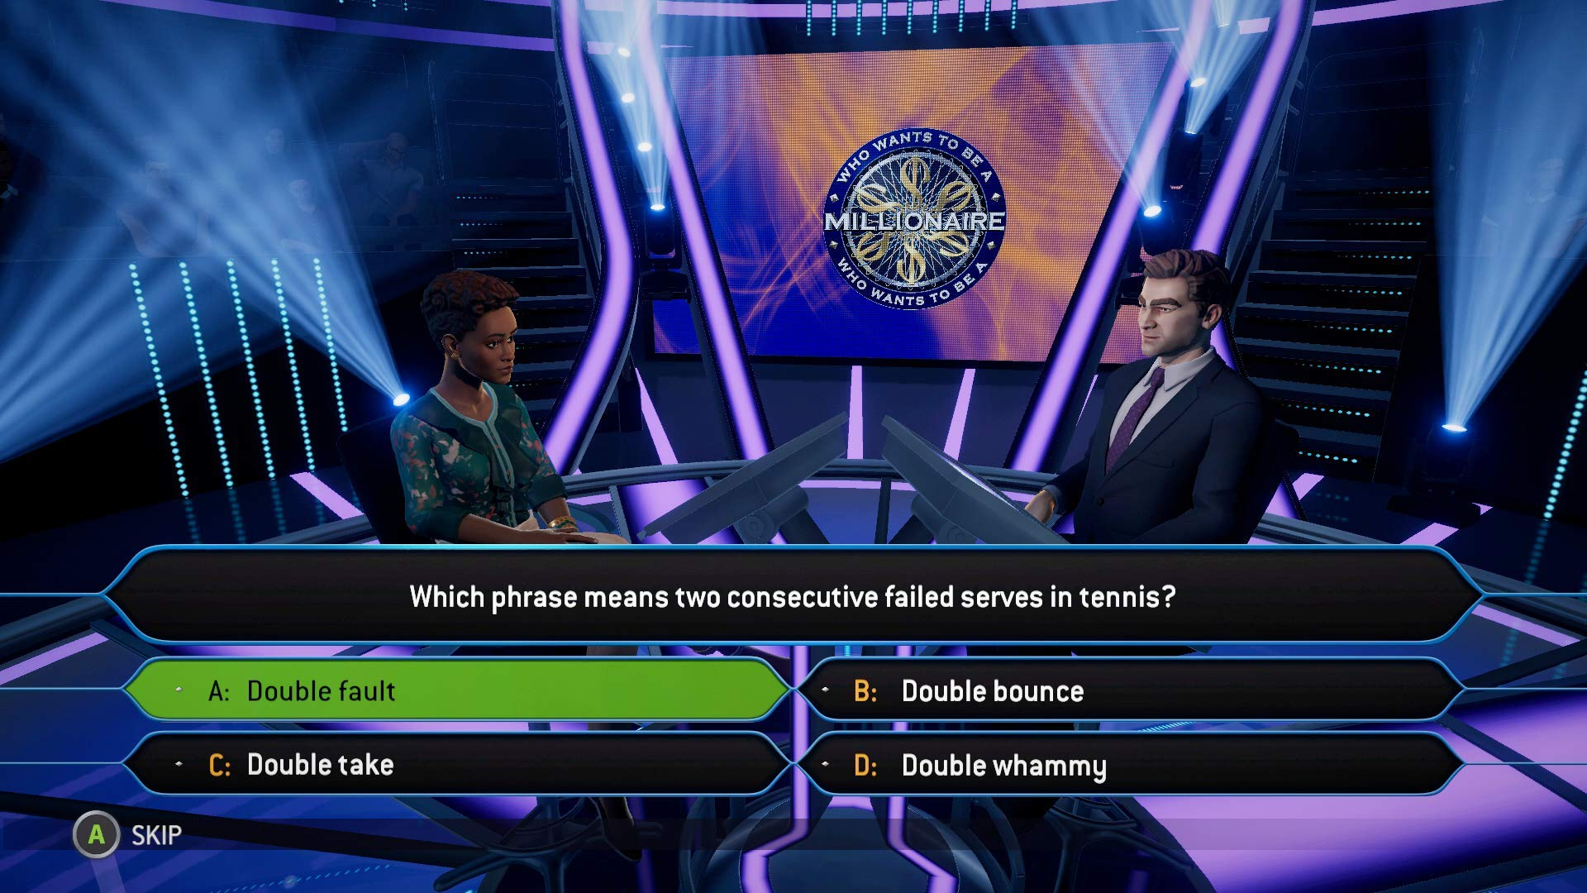

Slide 3
What is Prompt Engineering?

Slide 4
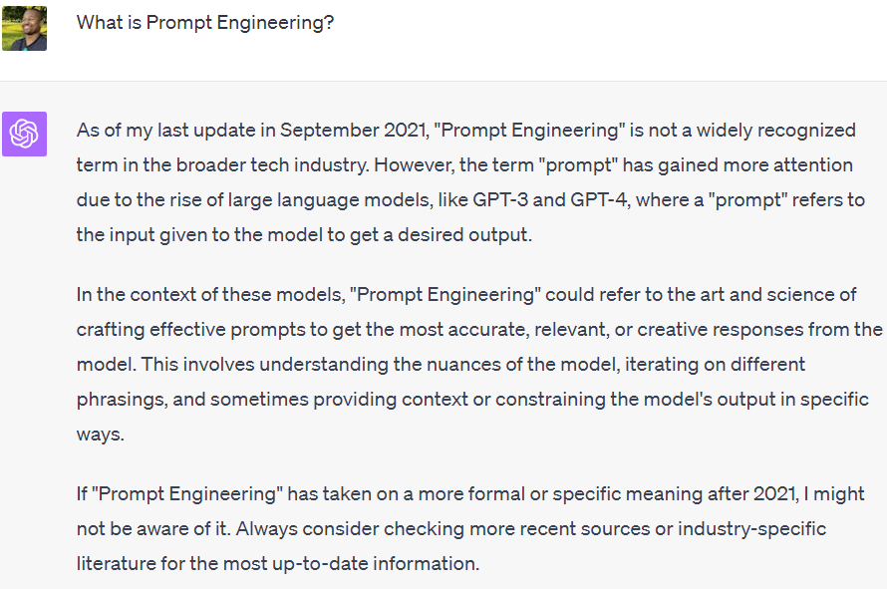

Slide 5
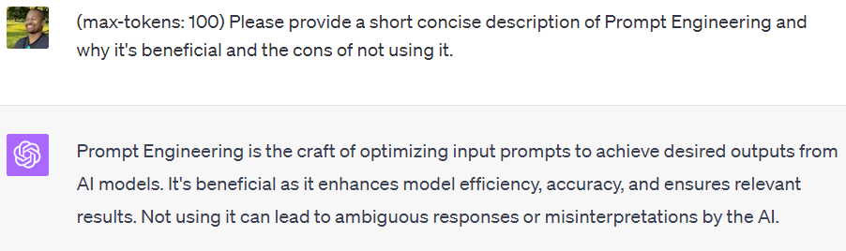

Slide 6
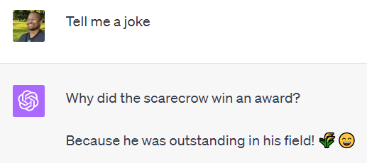

Slide 7
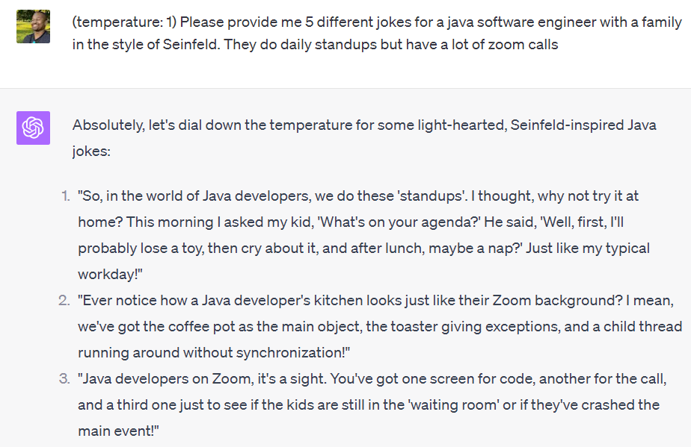

Slide 8
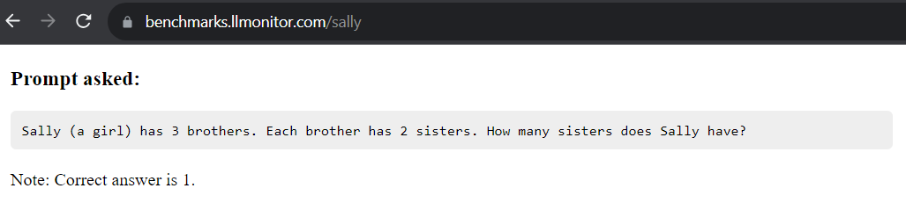
TIP! Pick the right LLM (Large Language Model)

Slide 9

Image Source:
https://ideogram.ai/g/hmzRxJexR8O9uzlCR_iORw/3

Slide 10
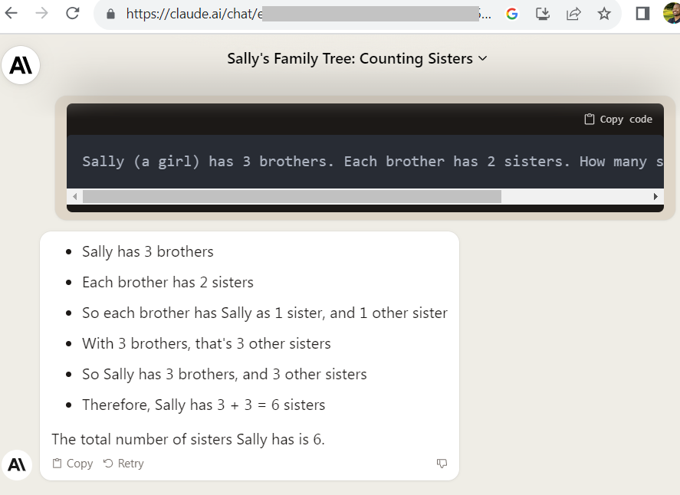

Slide 11
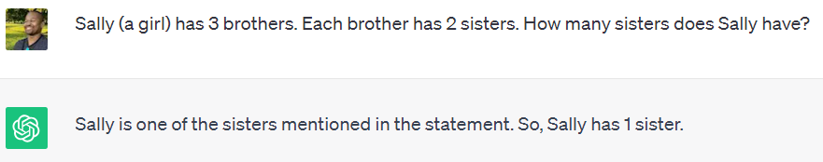
ChatGPT 3.5 Turbo (Aug 3, 2023)

Slide 12
What can I do with LLM?

Slide 13
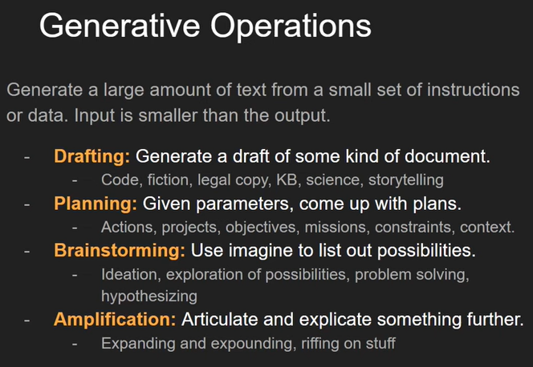
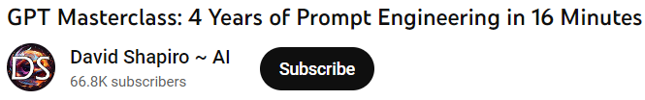
Input < Output

Slide 14
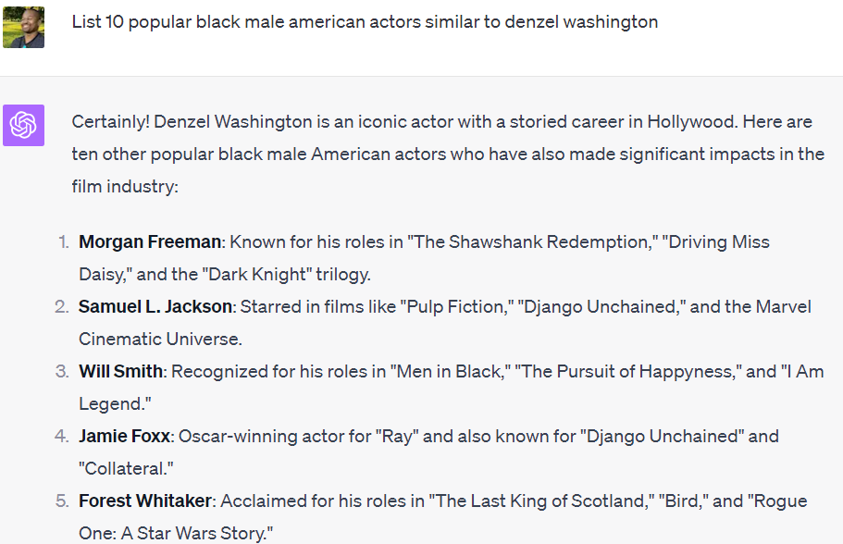

Slide 15
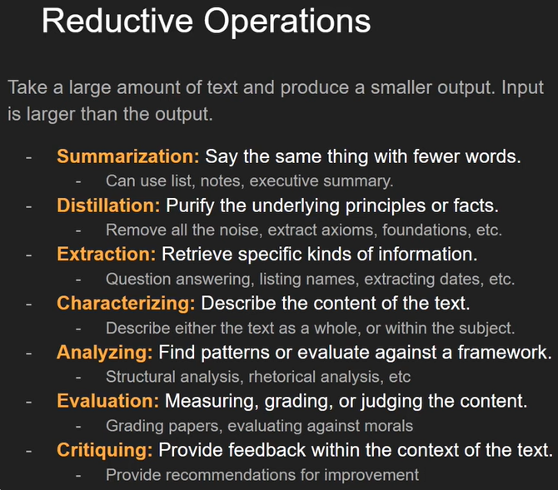
Input > Output

Slide 16
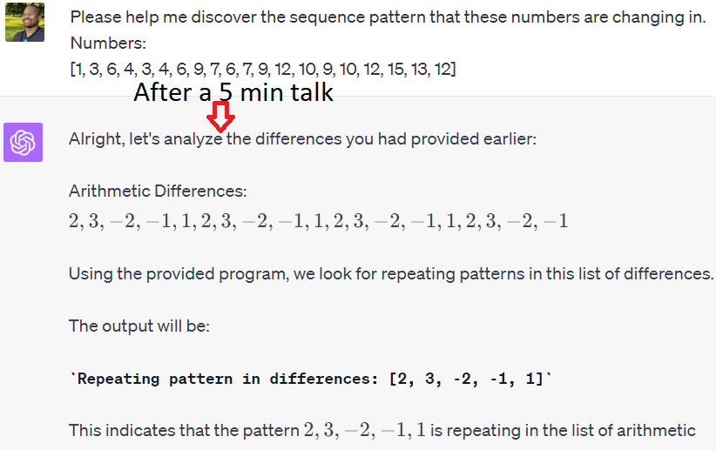

Slide 17
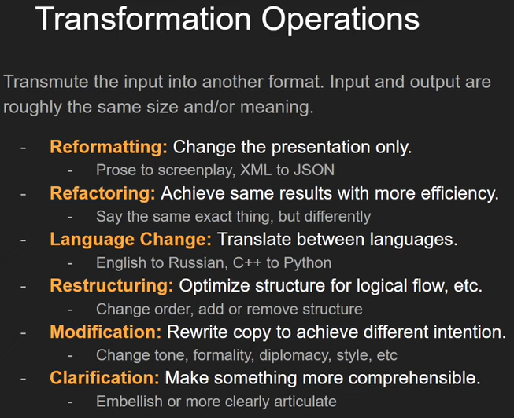
Input ~= Output

Slide 18
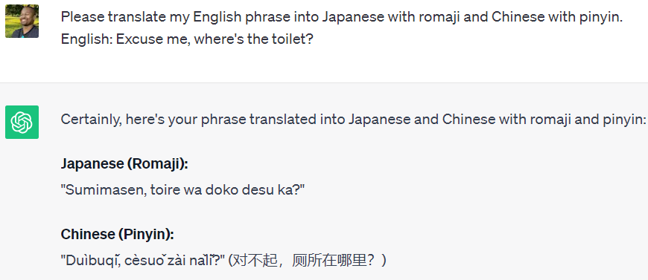

Slide 19
Creating the perfect Prompt

Slide 20
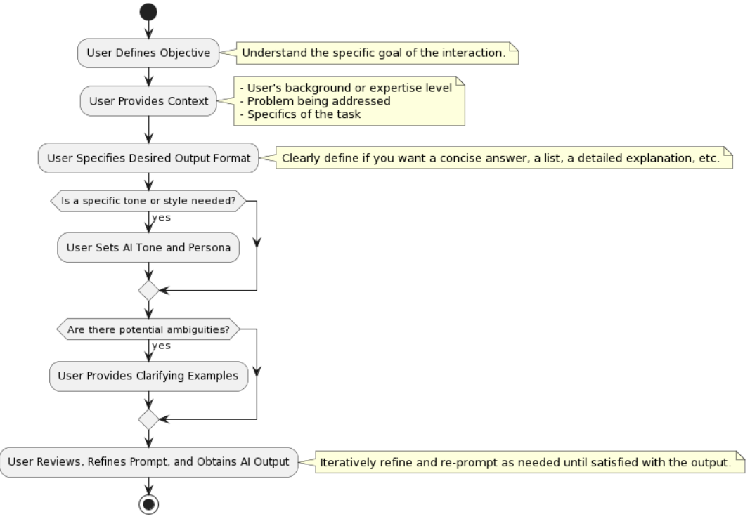

Slide 21
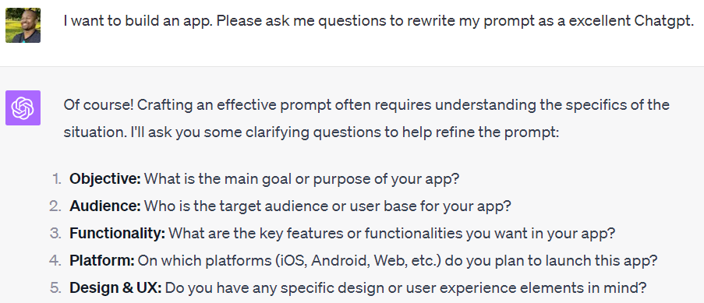

Slide 22
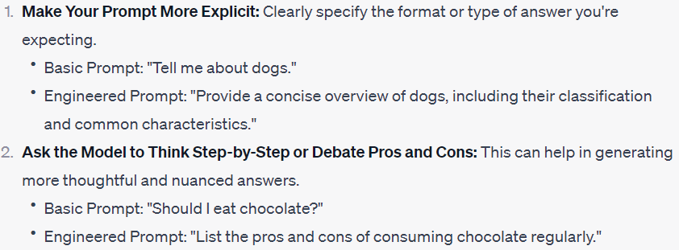

Slide 23
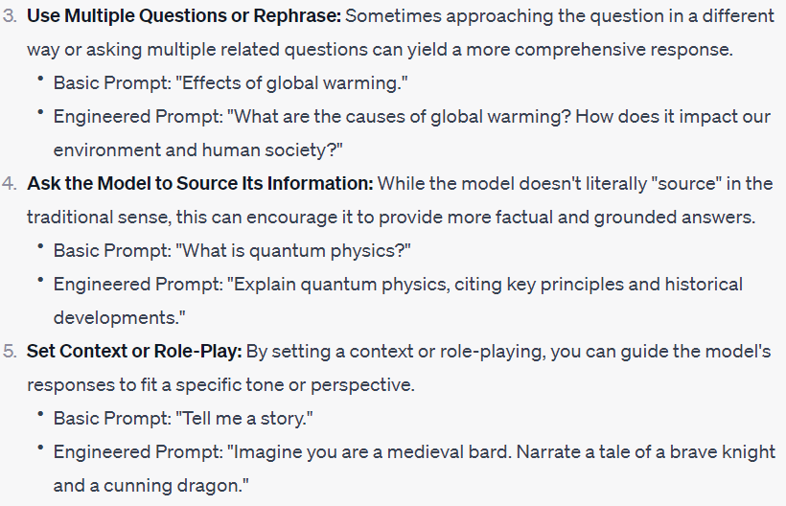

Slide 24
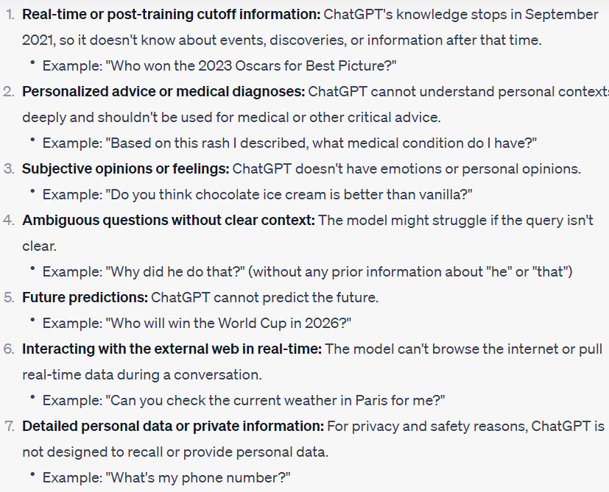

Slide 25
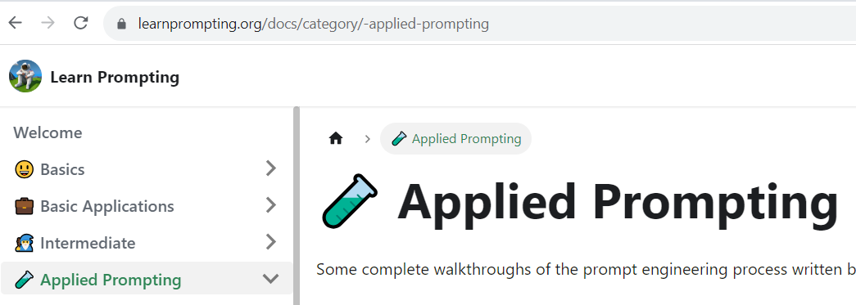
Learn more
LearnPrompting.org

Slide 27
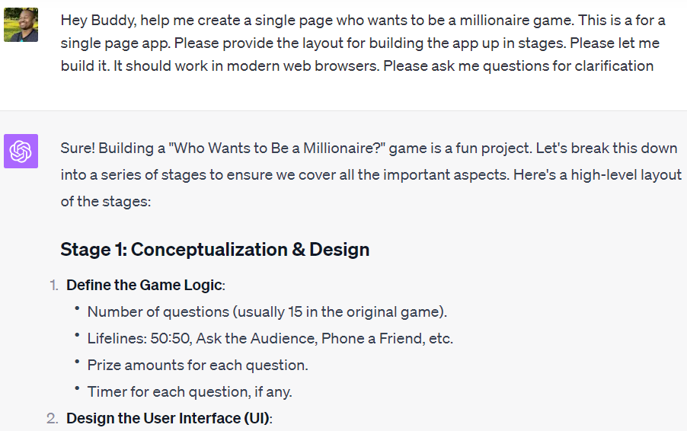

Slide 28
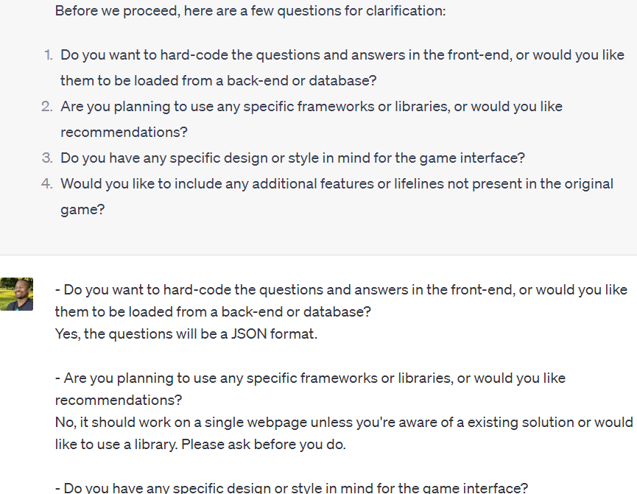

Slide 29
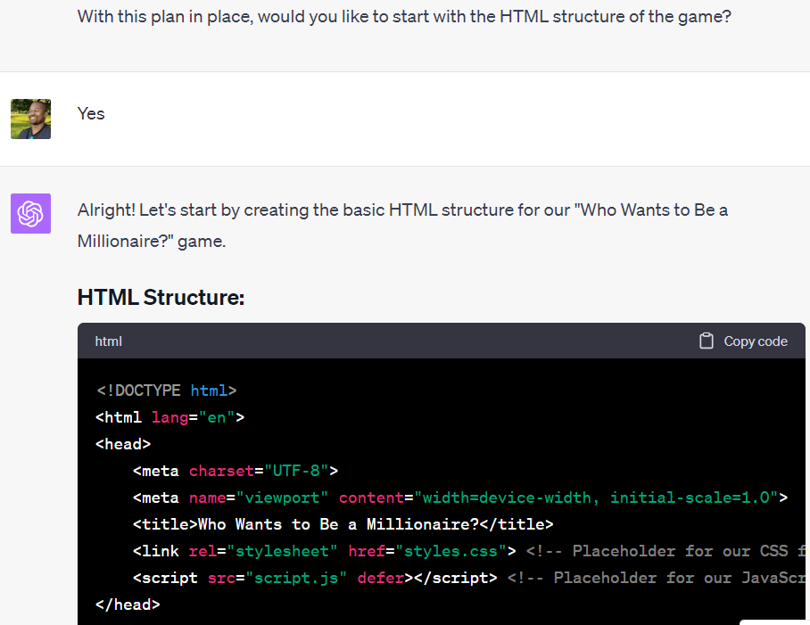

Slide 30
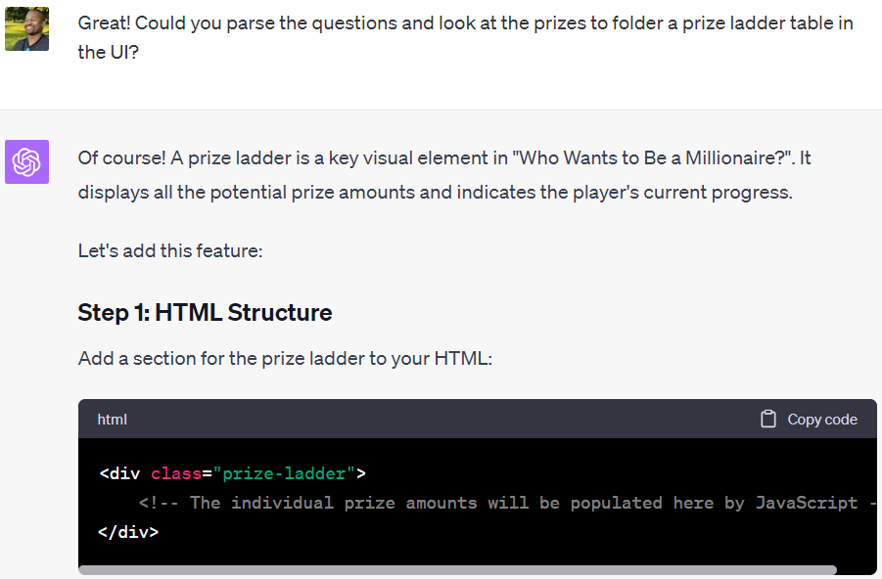

Slide 31
After 2 hours of work ….

Slide 32
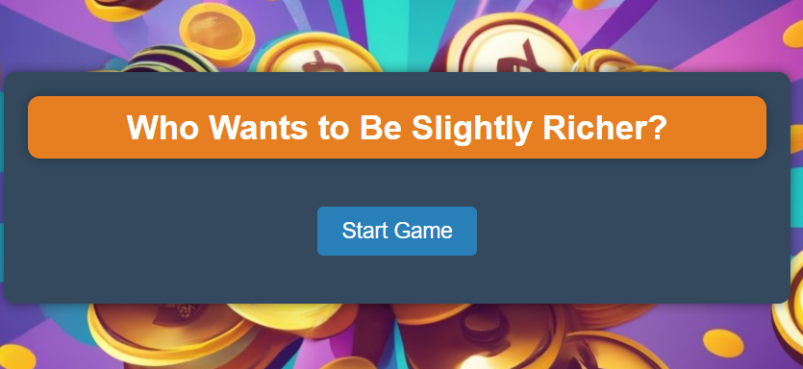
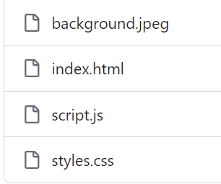
DEMO
https://www.larrybattle.me/p/game_show

